Slide 1

Global expansion of an early stage SaaS business
Submitted by: Ujjwal Kumar
Board of Directors | The sales and marketing team
Focus on large companies that would have survived the economic aftershocks and have the ability to pay. | Being on ground, strongly believes that: Focus on retail stores and chains as businesses have become more localized / closed to home. Pharma and grocery stores are doing well. The Head of Sales has hypothesized that the areas of online shopping that have grown during the pandemic are a good indicator of these verticals scaling up offline/in retail mode as well, as things start coming back to normal gradually.

Slide 2
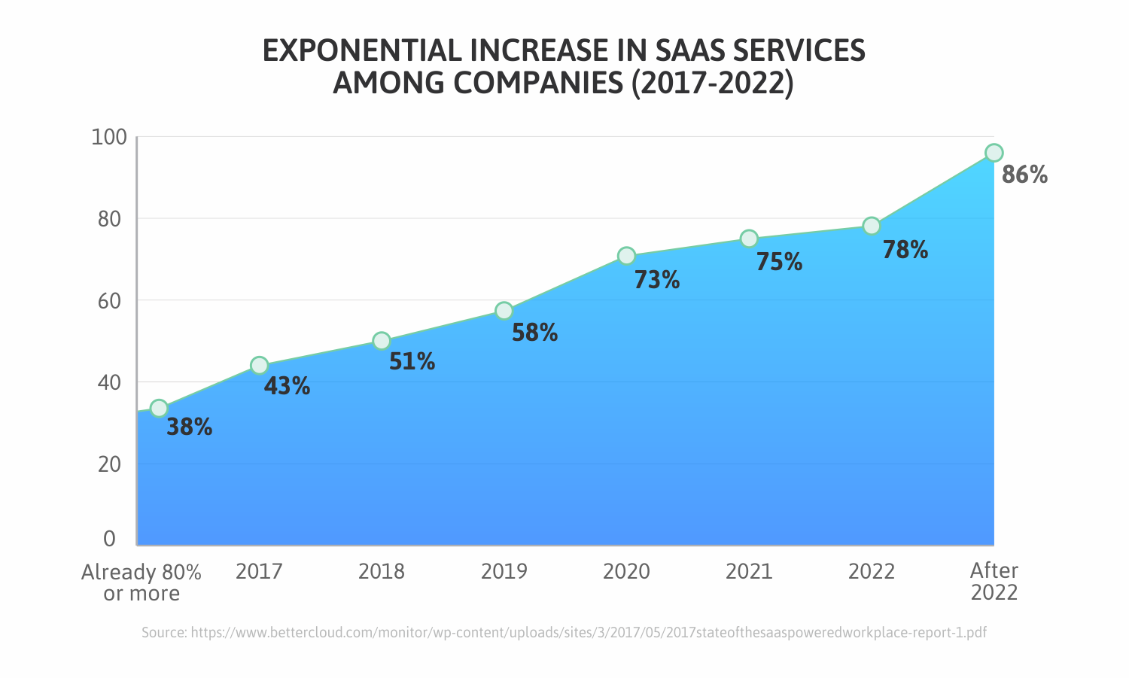
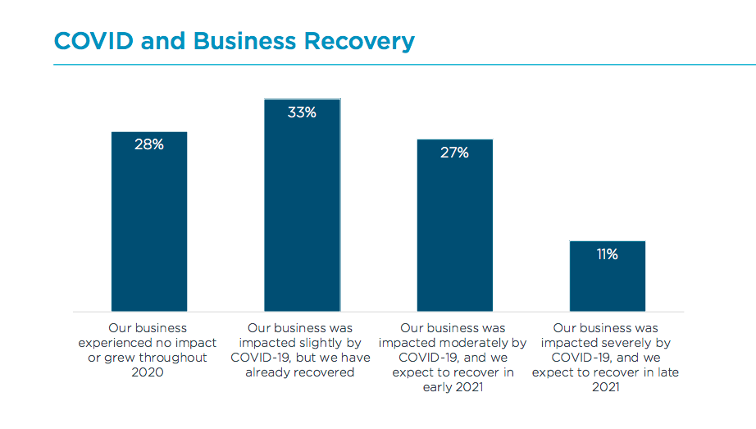
Covid impact on SaaS Market

Slide 3
Deciding the Ideal Target Market
Big Giants | Local Retailers (small business)
Good Revenue Customer Retention but needs time to gain acceptability. Image to company (Building an image in market) One time effort, important customers. | Seasonal growth for now Unstable, will require training Less revenue and more data distribution, Difficult to approach them, needs more energy but has the opportunity to switch to masses i.e (a common product).
Value : 70% time & energy(0.7) | Value : 30% time & energy(0.3)_

Slide 4
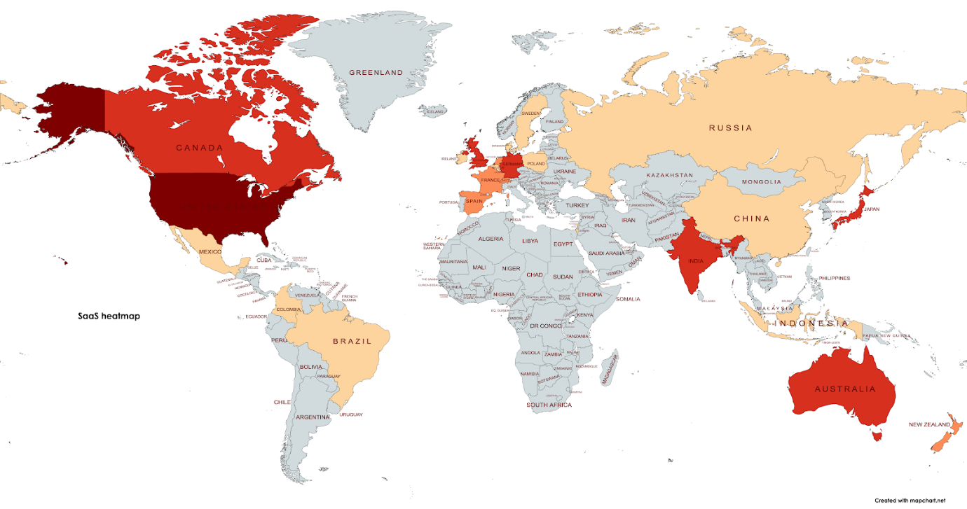
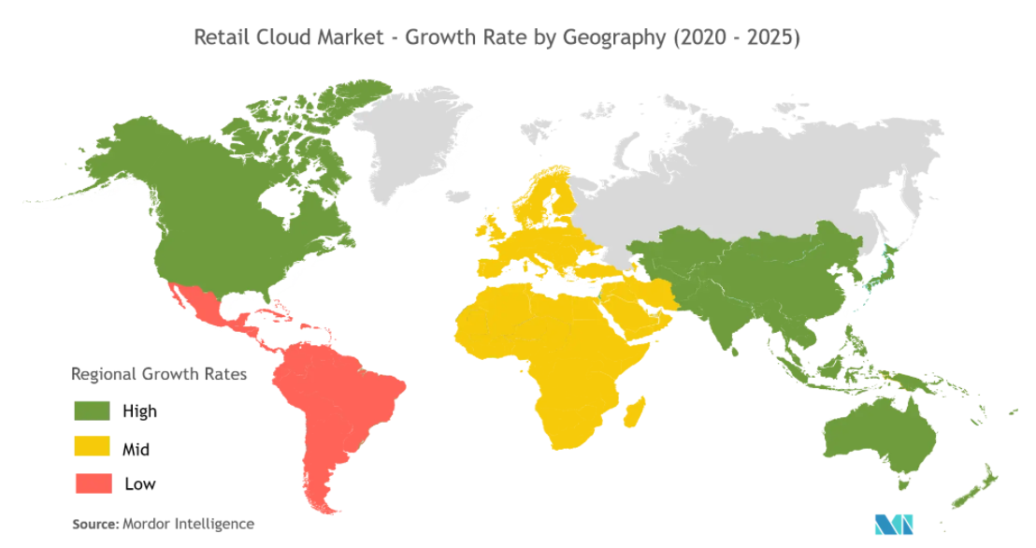
Countries where we can expand
Heat map of SaaS world, ranging by the size of revenue
Regional growth rates of retail SaaS businesses
Based on the growth rate, no. of companies, investment and the potential amount of revenue that can be generated, we can shortlist the top three countries as : United States, United Kingdom, Netherlands and Canada.

Slide 5
Market Segment to Focus | Reasons from the Sources | Validation, contribution and value
Retail segment and Merchandise stores. | Retail in emerging economies is growing, Enterprise retailers are re-architecting their systems to support Unified Commerce (the systems that enable the procurement, sale and delivery of merchandise independent of the channel), and The rise of Cloud computing (along with its cost efficiencies). In the face of rapidly changing consumer lifestyles and shopping habits, businesses are finding the need to pivot quickly to stay competitive in today’s landscape | Listrak reports a 40% increase in ecommerce revenue since the U.S. declared a state of emergency. Calculate the number of Retailers per country & sector Netherlands: Top ranking retailers in the Netherlands
Pharma Sector | Data Automation, Predicting the health case in advance, regular update of bed availability, medicines, health update, critical health, possibility to take to new centre, monitoring patient at home etc. needs automation and updation. • Largest US pharmacy by prescription revenue share https://www.marketsandmarkets.com/Market-Reports/covid-19-impact-on-cloud-computing-market-86614844.html | This is the sure market as here we have :- More demand Need of centralised database to be reported. Different and well defined chain system. Capital to pay and branches in different area. Hence, we may suffer from loss in no. of licenses issued but we ll have our customer.

Slide 6
Conclusion
The global Software as a Service (SaaS) market size is projected to reach USD 307.3 Billion by 2026, from USD 158.2 Billion in 2020, at a CAGR of 11.7% during 2020-2026.
70% of effort on big companies and 30 % on retail business.
It’s the peak time for us to expand globally when the SaaS business is growing at such an unprecedented rate.

Slide 7
References
https://getlatka.com/companies/countries
https://www.retail-index.com/HomeSearch/CalculateNumberofRetailerspercountrysector.aspx
https://getlatka.com/companies/countries/netherlands
https://www.businesswire.com/news/home/20210517005446/en/Global-Total-Retail-Software-and-SaaS-Market-Report-2020---ResearchAndMarkets.com
https://www.retail-index.com/Countries/ToprankingretailersintheUK.aspx

